Slide 1
Tutorial 7 – Parameter Estimation
PSYC 2020J
November 10, 2022

Slide 2
Review from Tutorial 6

Slide 3
Central Limit Theorem
Shape of sampling distribution approaches normal as the number of samples we take approaches infinity
The mean of the sampling distribution is the same as the population with a sufficiently large number of samples
The standard deviation of the sampling distribution (standard error, SE) of the mean is smaller than the standard deviation of the population
𝑆𝐸 = 𝜎 = ^{𝜎}
̅ _{𝑛}
x
𝑥

Slide 4
Central Limit Theorem
𝜎 = ^{𝜎}
𝑥̅ _{𝑛}
𝜎_{𝑥̅} – Standard error (standard deviation of the sampling dist. of the mean)
𝜎 – Standard deviation of the population
n – Sample size

Slide 5
SE vs SD
SE
Inferential about the population
Based on the sampling distribution
SD
Descriptive of a sample
Based on the distribution of the samples
“In other words, SD indicates how accurately the mean represents sample data. However, the meaning of SEM includes statistical inference based on the sampling distribution. SEM is the SD of the theoretical distribution of the sample means (the sampling distribution).” (Investopedia, 2021)

Slide 6
New material

Slide 7
Parameter Estimation
We use our sample to make inferences about the population
Really, this is the basis of many psychological inquiries
We have to estimate it
This is the basis of NHT

Slide 8
Point vs Interval Estimates
Point Estimates
Result of a computation to approximates a parameter
A single value to estimate the parameter
Interval Estimates
Result of a computation to estimate a range
A range where you estimate the parameter will fall within

Slide 9
Confidence Intervals (CI)
The range where we expect our parameter to lie (based on our estimation through calculation)
We use a probability to describe and construct this interval
Level of confidence
95% is the psychology standard
CIs rely on standard error

Slide 10
Confidence Intervals (CI)
We estimate the parameter at a given confidence level, and get the interval
E.g., “We estimate the mean age to be 20 years, 95% CI [19, 21]
CIs rely on standard error
We either know Standard error (we know the distribution of the population)
We don’t and have to estimate it (the t-distribution)
𝐶𝐼 = 𝑥̅ ± 𝑧(𝜎_{𝑥̅})

Slide 11
Confidence Intervals (CI)
𝐶𝐼 = 𝑥̅ ± 𝑧_{𝛼}(𝜎_{𝑥̅})
𝑥̅ - mean
𝑧_{𝛼} - Z value at alpha level, 𝛼
“Z critical”
𝜎_{𝑥̅} - Standard Error of the mean (SEM)
•
𝜎
n
𝑛

Slide 12
Constructing CI when we know 𝜎_{𝑥̅} use Z
Pick a level of confidence, 𝛼
This is set at .05 as a convention (more on this to come!)
Find your z critical using the Z table
3) Calculate 𝜎_{𝑥̅} using ^{𝜎}
n
𝑛
Calculate the interval (𝑧_{𝛼}(𝜎_{𝑥̅}))
Plug this into the CI formula (𝑥̅ ± 𝑧_{𝛼}(𝜎_{𝑥̅}))
Remember to do the upper and lower limits
Interpret

Slide 13
What do we do when we don’t have 𝜎_{𝑥̅}?
This is more often than not the case
We typically don’t know the pop, which is why we estimate it!
We estimate 𝜎_{𝑥̅} using the sample standard deviation, 𝑠
𝑠
𝑠_{𝑥}=
-
n
𝑛
BUT, we also can’t use z! (Why?)

Slide 14
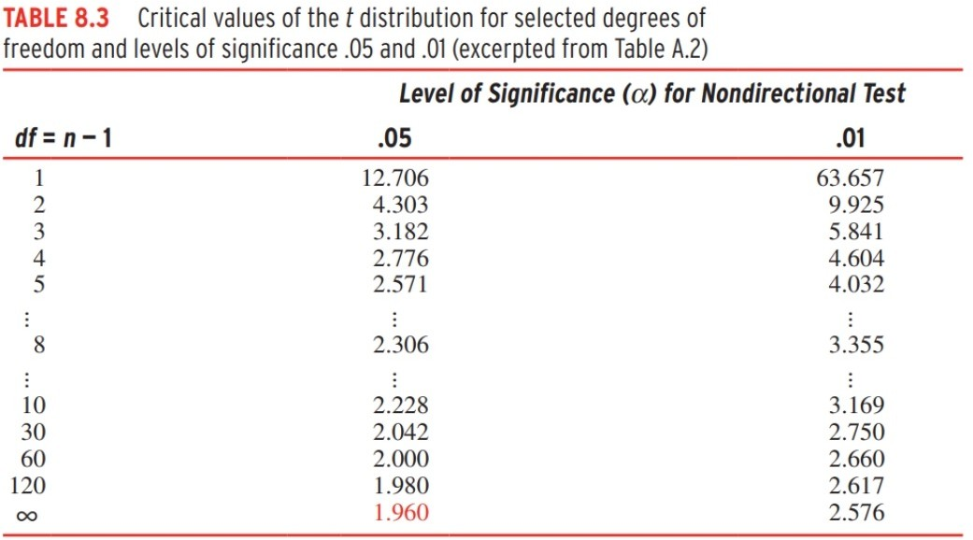
The t distribution
Uses df, degrees of freedom
df = n-1
Has slightly different critical values for the given, 𝛼
Notice, as N increases, we approach 1.96 for t
This lowers the SEM
If df is infinite (or very very large), then the t distribution approaches normality and z = t

Slide 15
Constructing CI using the t distribution
Same steps as before!
Pick a level of confidence, 𝛼
This is set at .05 as a convention (more on this to come!)
Find your t critical using the t table
3)
4)
5)
-
Calculate 𝒔_{𝒙} using
𝒔
𝒏
Calculate the interval (𝒕_{𝑎}(𝒔_{𝒙}))
Plug this into the CI formula (𝑥̅ ± 𝒕_{𝑎}(𝒔_{𝒙}))
Remember to do the upper and lower limits
6) Interpret
Notes:
-

Slide 16
More on understanding CI
We get an interval around our parameter estimate at a given level of confidence
“We are 95% confident that 𝜇 fall within the interval”
The width of the CI is impacted by many factors
Narrower CIs are good
If we have more people, CI is narrower
If we have a smaller sample SD, CI is narrower
If we are less confident (lower 𝛼), our CI is narrower**
Having known 𝜎_{𝑥̅} makes CI generally narrower
t is bigger than z is df is small

